Slide 1
Bài giảng điện tử
Unit 1: Towns and Cities
Lesson 4: Vocabulary + Listening

Slide 3
OPEN! SESAME!

Slide 4
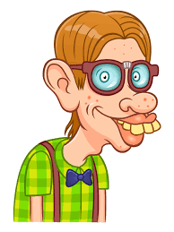
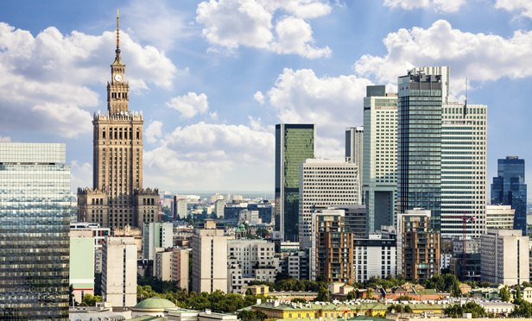
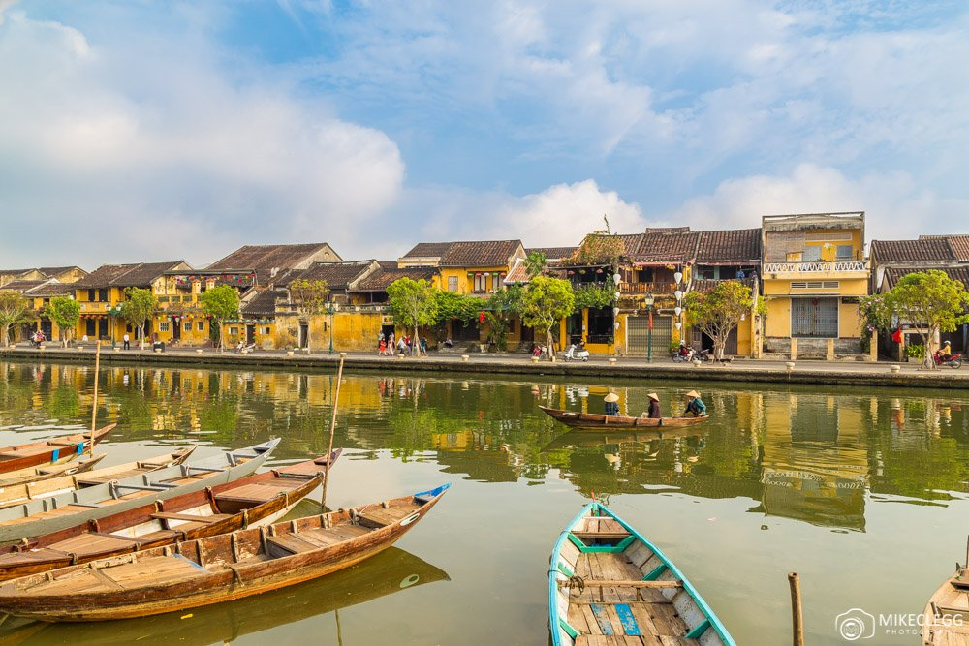
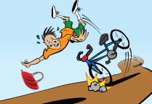
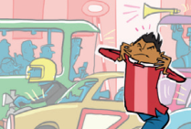
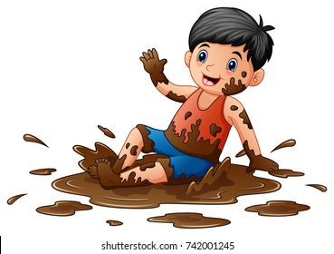
1
2
unfriendly
4
3
5
6
7
8
pretty
quiet
old
9
10
11
12
safe
clean

Slide 5
Do you like modern or old places? Why?

Slide 6
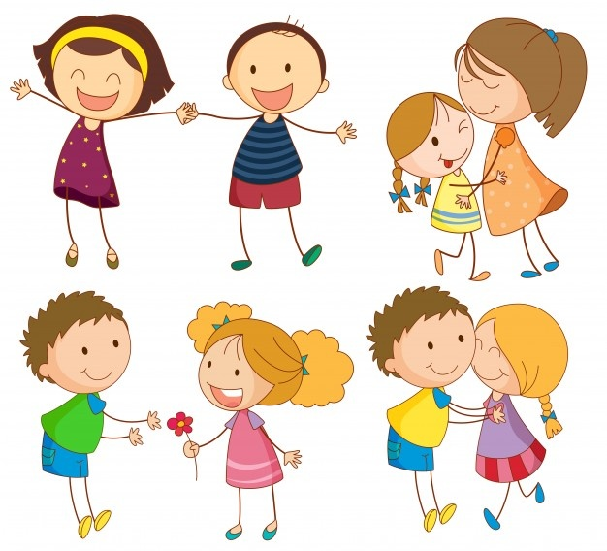
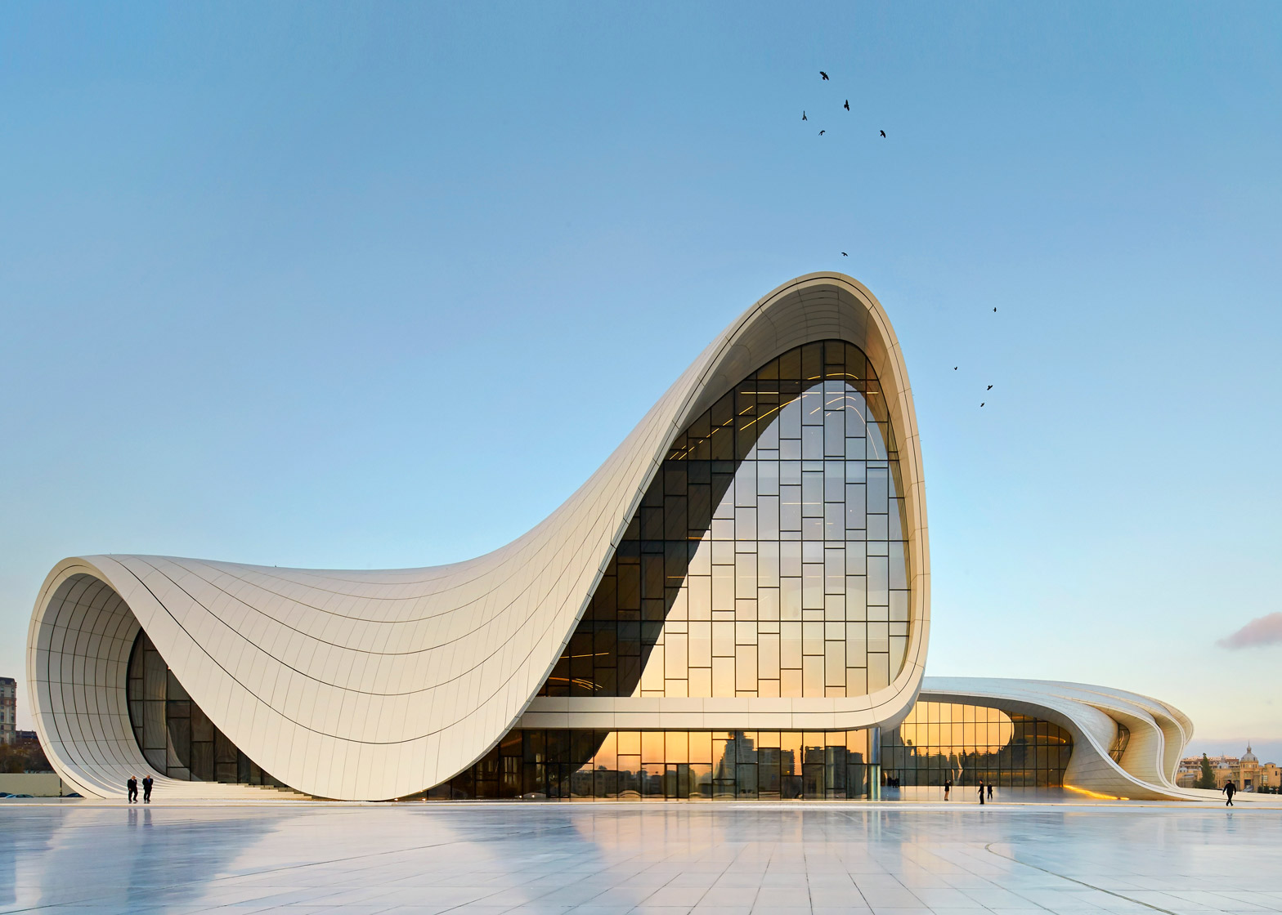
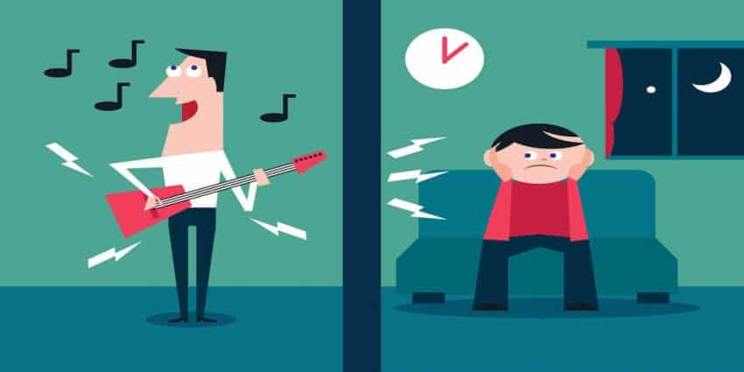
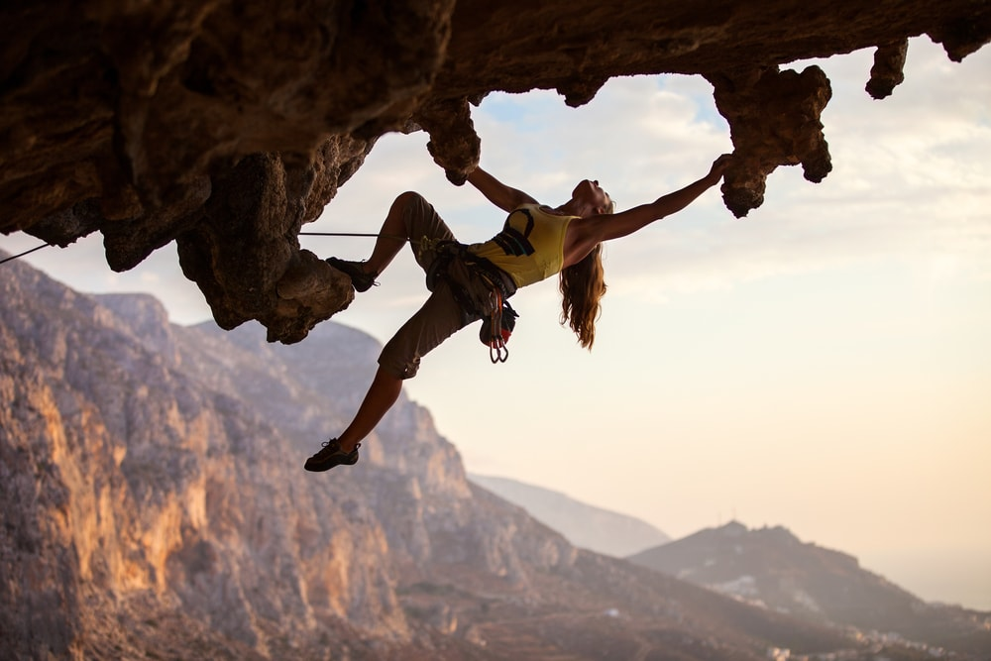
New words
- dirty (adj)
≠ clean
- dangerous (adj)
≠ safe
- noisy (adj)
≠ quiet
- modern (adj)
- ugly (adj)
≠ pretty
- friendly (adj)

Slide 7
Write sentences for the adjectives in exercise 1.

Slide 8
Listen to four street interviews in a radio programme. What do people talk about? Choose four topics from the box and match them to the people.
the park
Emma:
buses and bikes
Lukas:
New York
Dwayne:
restaurants
Chloe and Harriet:

Slide 9
TRUE – FALSE QUIZ
T
1) Emma thinks that the shopping centre is cleaner than the park.
T
2) Lukas thinks that the bus is slower than his bike.
F
3) Lukas thinks that
buses are more dangerous than bikes.
bikes are more dangerous.
4) Dwayne thinks that Oxford is nicer and older than his city.
T
F
5) Harriet thinks that
Luigi’s pizzas are bigger.
Gino’s pizzas are bigger and better.
6) Chloe thinks that Gino’s is friendlier.
T

Slide 10
Answer the questions

Slide 11
Who does Emma meet at the shopping centre?
What does Lukas say about the price of the buses?
Where is Dwayne from?
What does Harriet agree with Chloe about?

Slide 12
LUCKY NUMBERS
1
2
3
4
5
6

Slide 13
Answer the question
Who does Emma meet at the shopping centre?
➔ She meets her friends at the shopping centre.

Slide 14
Answer the question
2) What does Lukas say about the price of the buses?
➔ They are expensive.

Slide 15
Answer the question
3) Where is Dwayne from?
➔ He is from New York.

Slide 16
Answer the question
4) What does Harriet agree with Chloe about?
➔ The pizzas in Gino’s are better, and the people are friendlier.

Slide 17
You get 10 points !

Slide 18
You get 10 points !

Slide 19
Think of three places that you like in your town / city and three places that you don’t like. Write sentences and say why you like or dislike them.

Slide 20
MINDMAP

Slide 21
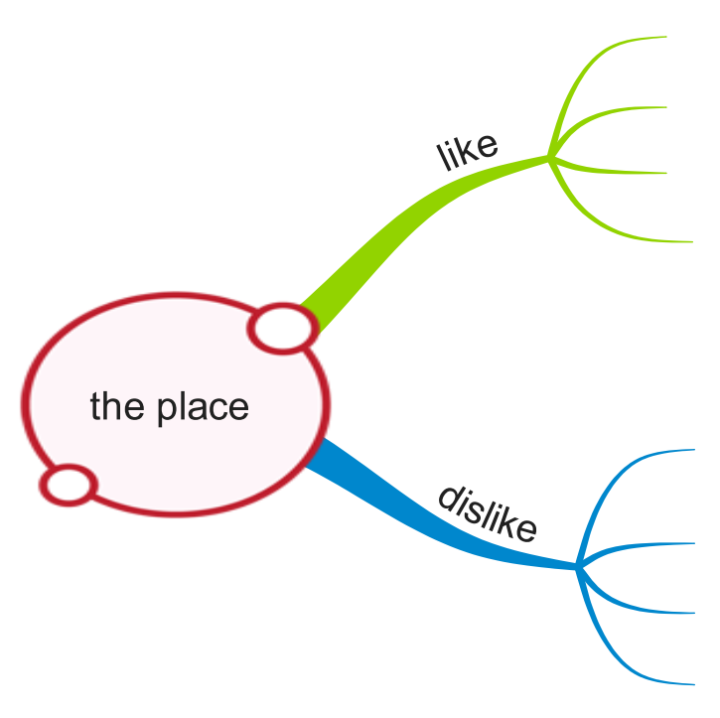

Slide 22
Homework
- Learn by heart all the new words.
- Prepare for next lesson – Language focus: comparative adjectives.

Slide 23
www.phuongnam.edu.vn

